Slide 1
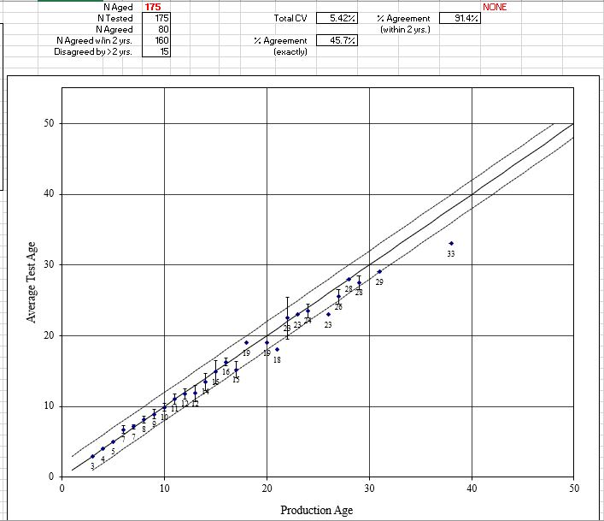
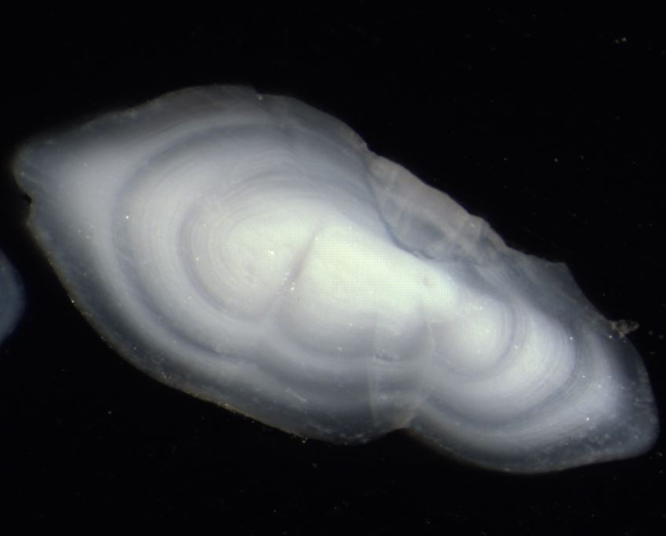
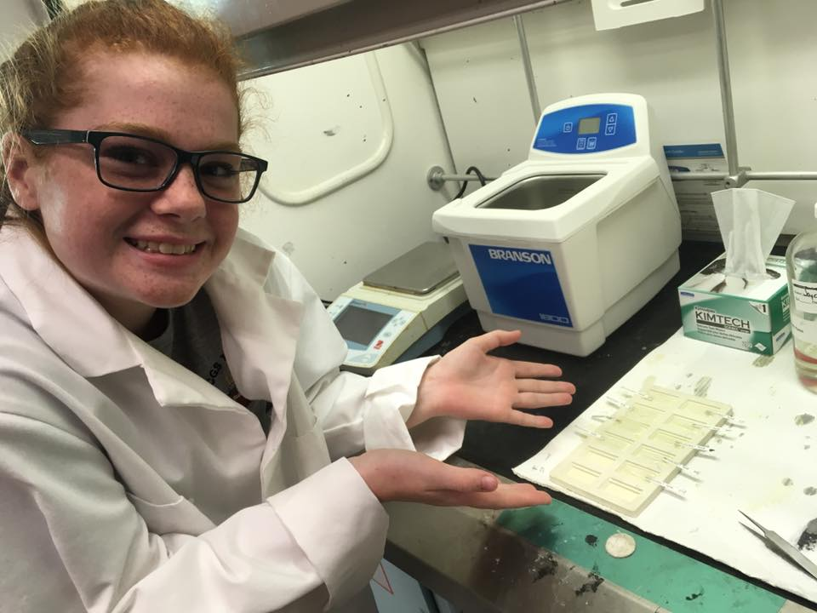
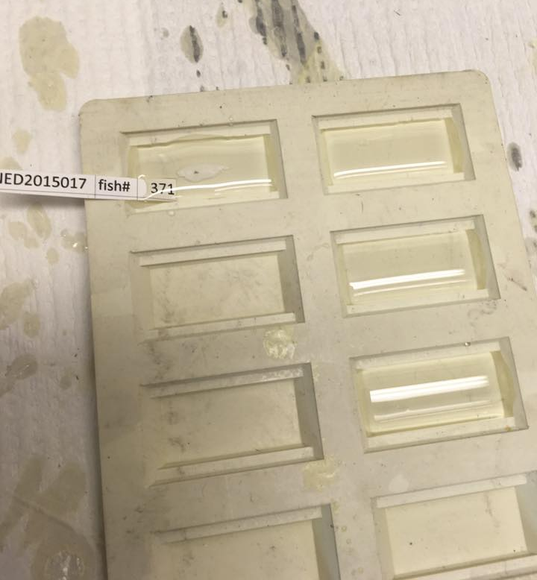
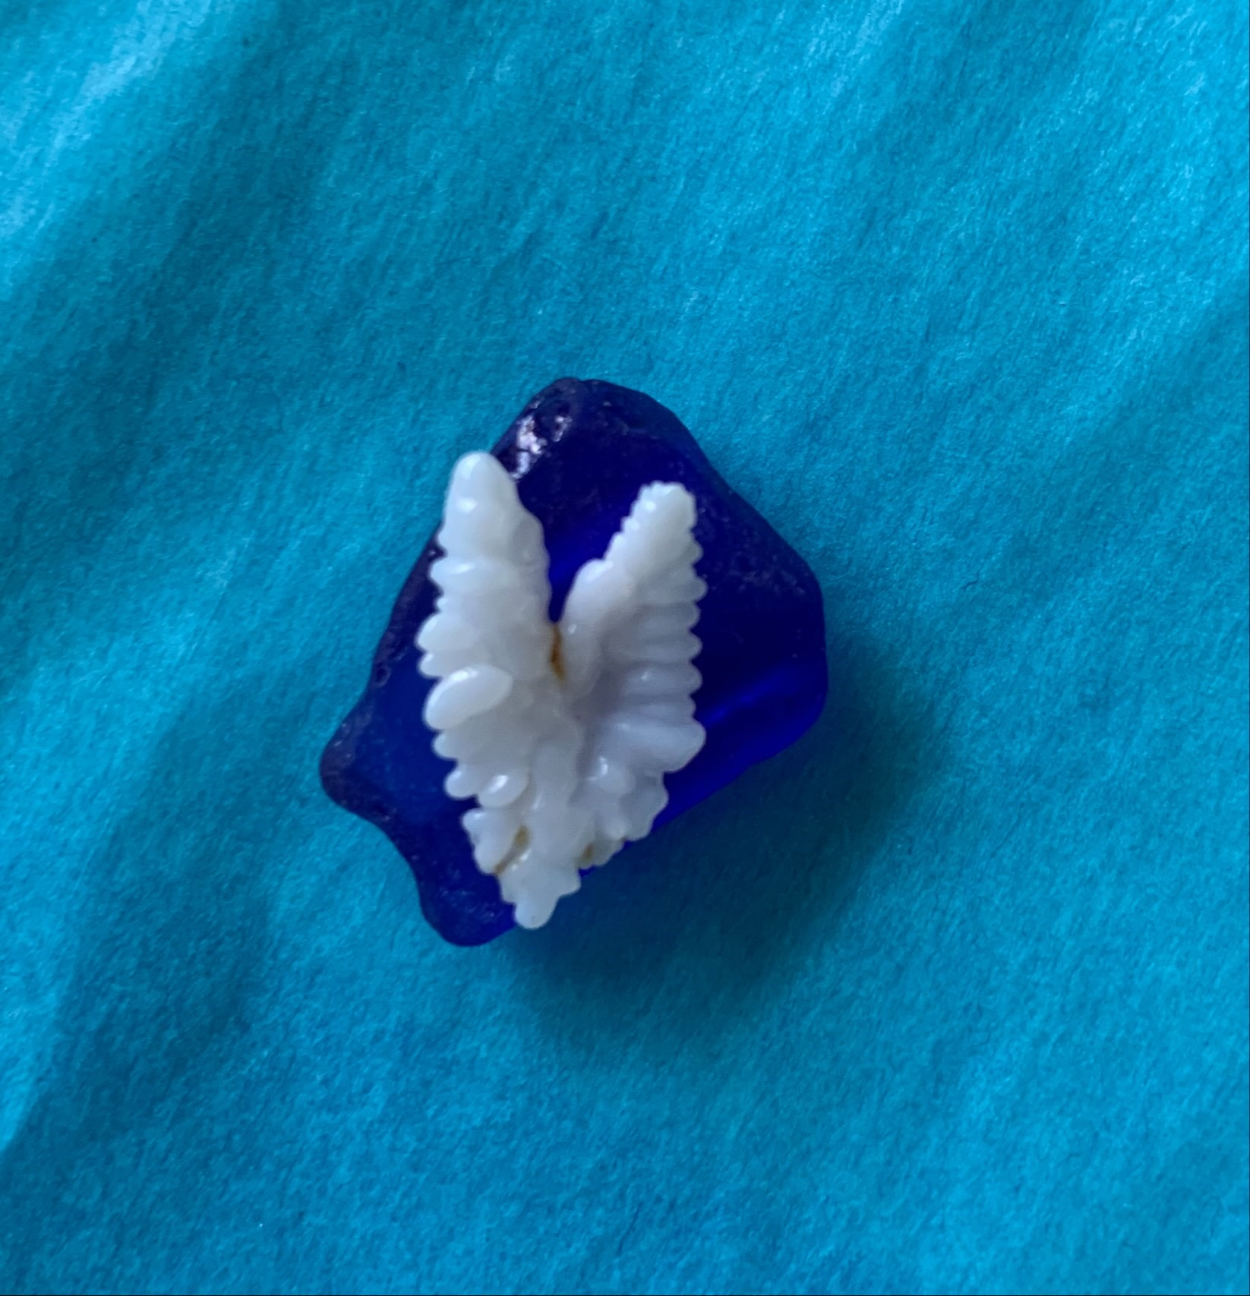
Reconciling dreams, expectations and reality in a production ageing environment

Slide 2
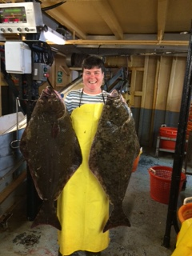
About me
Graduated from Dalhousie University in 1996 with Marine Biology BSc
Started my ‘career’ at BIO in 1995 working part time for the 4Vn Sentinel Survey, then went to fulltime with 4Vn Sentinel after grad. Worked contract, casual and terms until finally becoming indeterminate 10ish years later
Started ageing 4Vn Cod in 1996
Have aged Cod, Silver Hake, Cusk, Salmon &Trout (microstructure ageing), Surf clam and most recently Atlantic Halibut.
2004 hired on contract by AHC to do a major ageing project of Atl Hal (4000+ oto’s) this looked at stock areas 3Nop and 4VWX, blind side vs eyed side as well as exchanges with Pacific halibut commission.
My current role is not only as a fish ager. I am the lead technician maintaining the ISDB and Port Sample databases, I do port sampling, watch leader on the RV surveys, and I put out a lot of ‘fires’ for staff when they don’t know where to get the answers for things, or need a lesson in why things are the way they are in terms of corporate history.

Slide 3
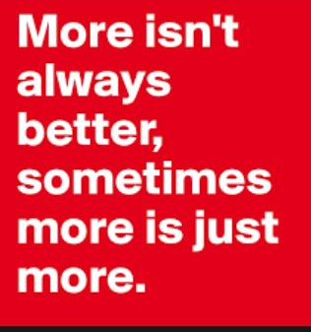
Whose dreams/ expectations and reality?
We age fish to improve our understanding of stock dynamics. The dreams/expectations of assessment leads sometimes feels like if they add a mazillion ages to their models the models will have better fit or be more predictive. But how many are really needed, and why do we need a mazillion?
The reality is that fish agers are often asked to provide ages for some number of fish, often that number has not really been well thought out, we just forge ahead with ‘more is better’.
I think careful consideration should be given to things like area/season/sex and appropriate numbers of each selected for ageing because…
Not only are we asked to provide ages, but we are asked to provide ages that are ‘RIGHT’
In my opinion there is a disconnect between the value of the actual ages(high) and the act of ageing itself(low). Assessment leads need to stop thinking of ageing fish as just ‘counting the rings’ and see the task for what it is, generating estimates of age based on a unique skill set. This takes time, patience, accuracy and precision.

Slide 4
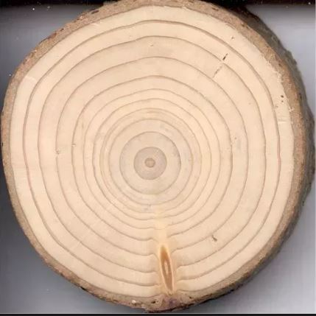
What is fish ageing?
-There is an overall feeling that fish ageing is JUST ‘counting rings’
which is what we tell a layperson we are doing when we are looking at ageing materials.
-Fish ageing is a lot more than just counting rings. It is a visual interpretation of pattern and pattern recognition
It is the ability to visually interpret a pattern and then do it repeatedly for the same sample

Slide 5
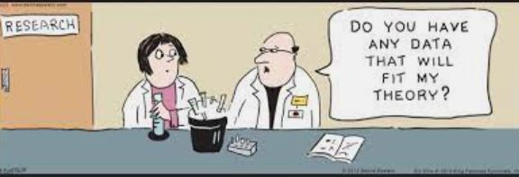
Bias?
Bias is anything that skews your interpretation of the ring pattern in an otolith/scale etc.
My personal feeling is you have to ‘know yourself’ If you will be influenced by knowing things about a fish (length, sex, season, area) then you are better off to exclude that information. For me, I age knowing as little as possible about the fish.

Slide 6
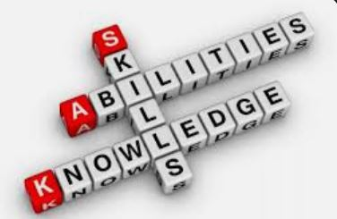
The Upside
Positive things about being an ager:
- skill set that is fairly unique
- appreciation for data collection techniques
- sense of being a contributor to the process or product

Slide 7
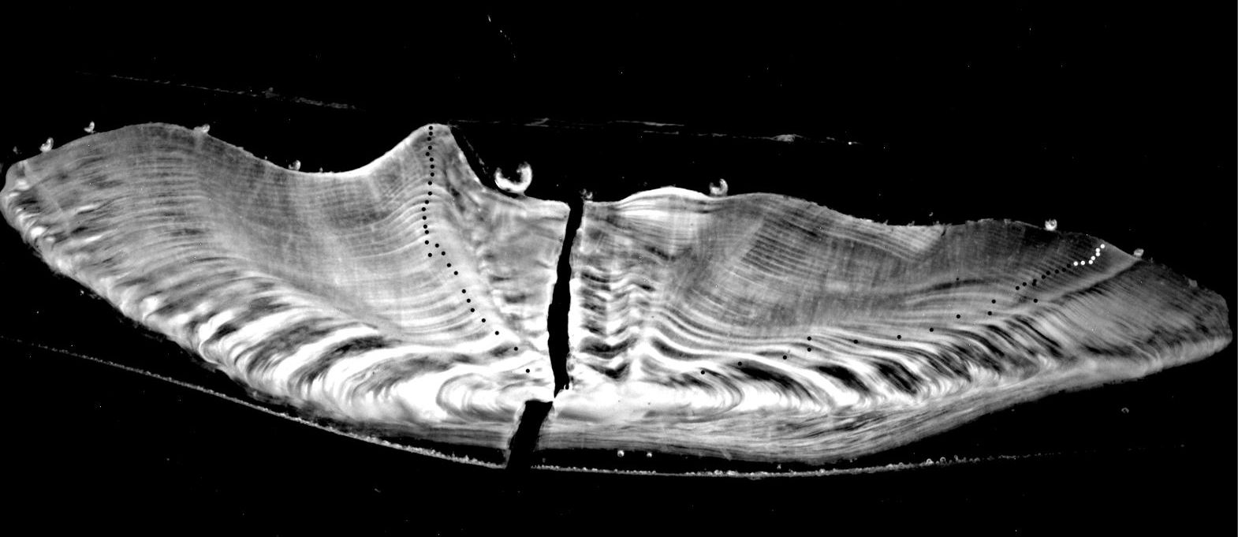
The End

